Slide 1
Segmentation of HUBMAP Kidney data
Rajashree Dahal

Slide 2
Outline
Objectives
Introduction
Problem Statement
Dataset
Methodology
Results
Conclusion

Slide 3
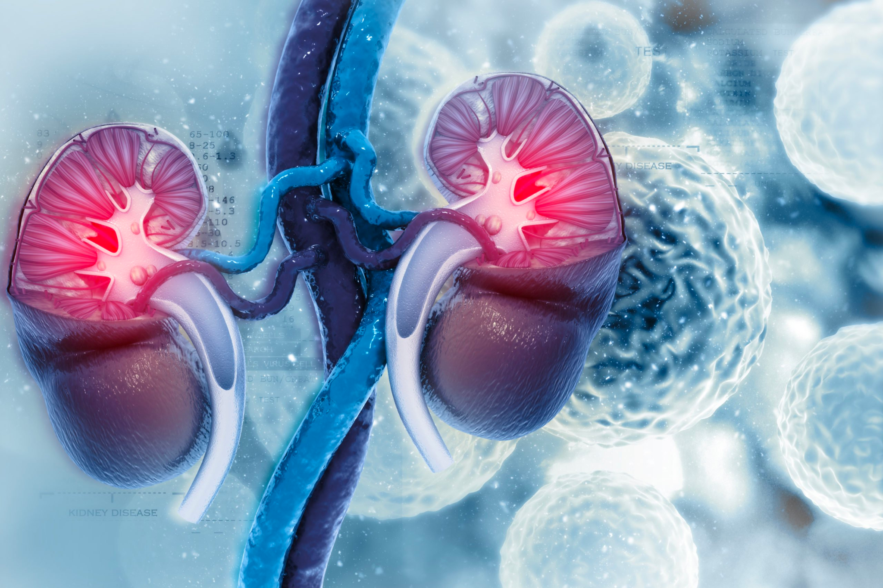
Objectives
Identify and segment the glomeruli in human kidney images using U-net Segmentation Model and obtain maximum possible values of performance metrics
Compare and analyze performance of different PCs applied to the same model
Reduce the dimension of the data such that computation complexity decreases.

Slide 4
5V
Introduction
Attempt to simulate creation of framework for mapping the human body at the level of glomeruli functional tissue units
Can be considered as Big Data in terms of 5Vs – Volume, Value, Variety, Velocity, and Veracity
Value
Volume
Veracity
Variety
Velocity

Slide 5
Problem Statement
Add insights on world’s understanding of the connections between cell and tissue structure and function and human health.
The mapping can help researchers identify new targets for therapies and develop new diagnostic tools to better treat kidney diseases, which affects millions of people worldwide.
Need of an expert to diagnose

Slide 6
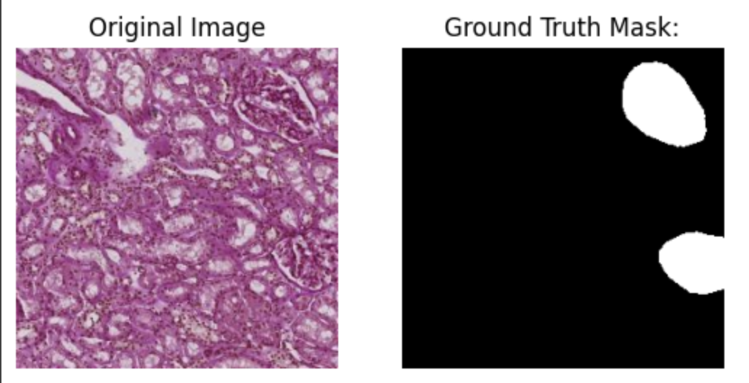
Dataset
Available in Kaggle
Original dataset: very large (>500 MB-5GB) TIFF files with 10 such files.
Used dataset: 9580 images with corresponding masks with 256*256 shapes
Figure: sample of dataset

Slide 7
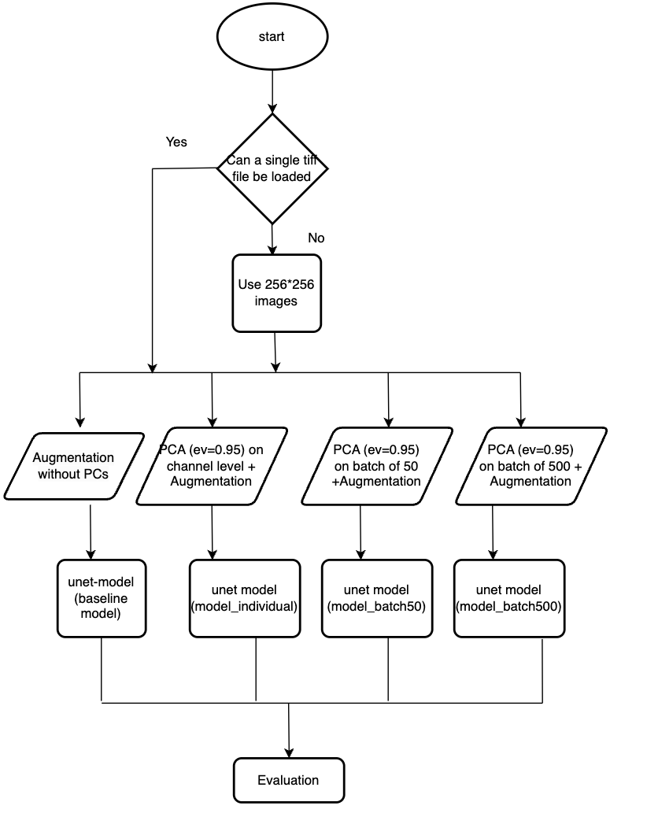
Methodology

Slide 8
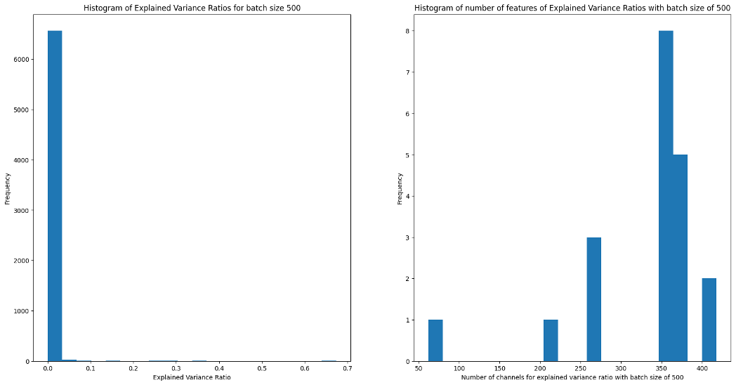
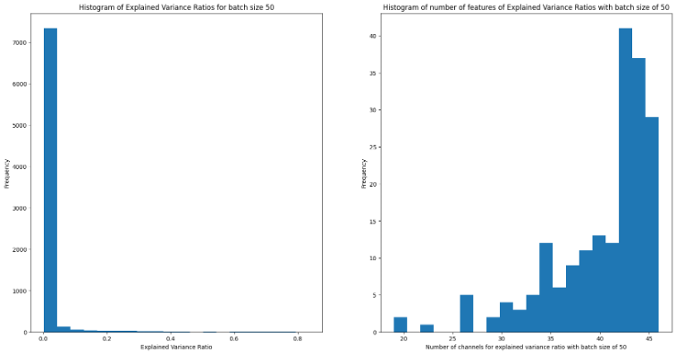
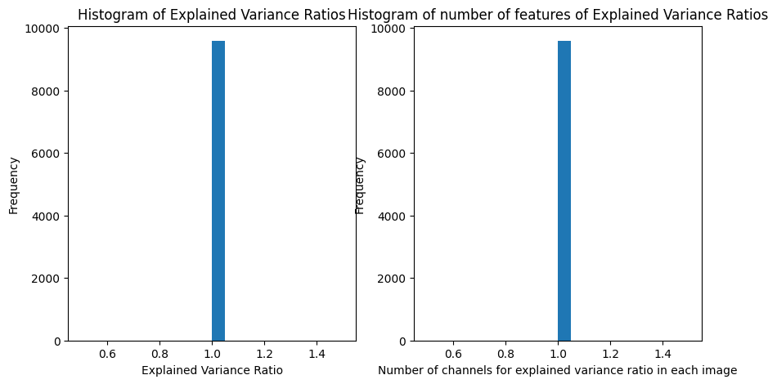
Results
PCs

Slide 9
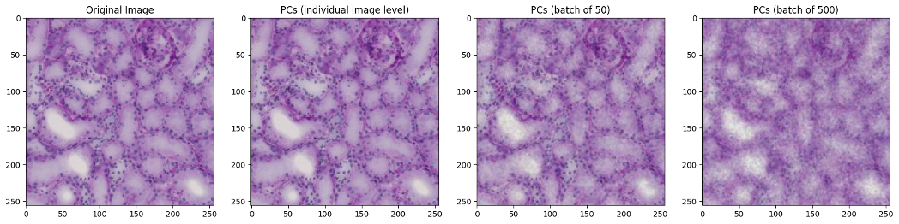
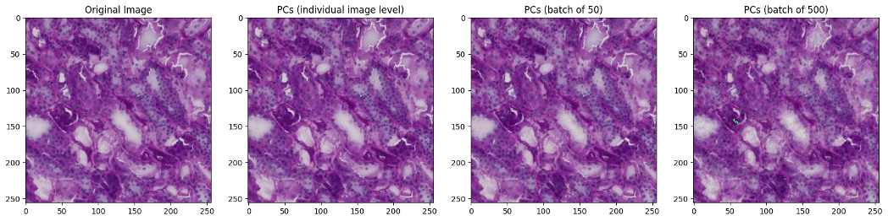
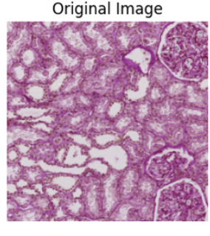
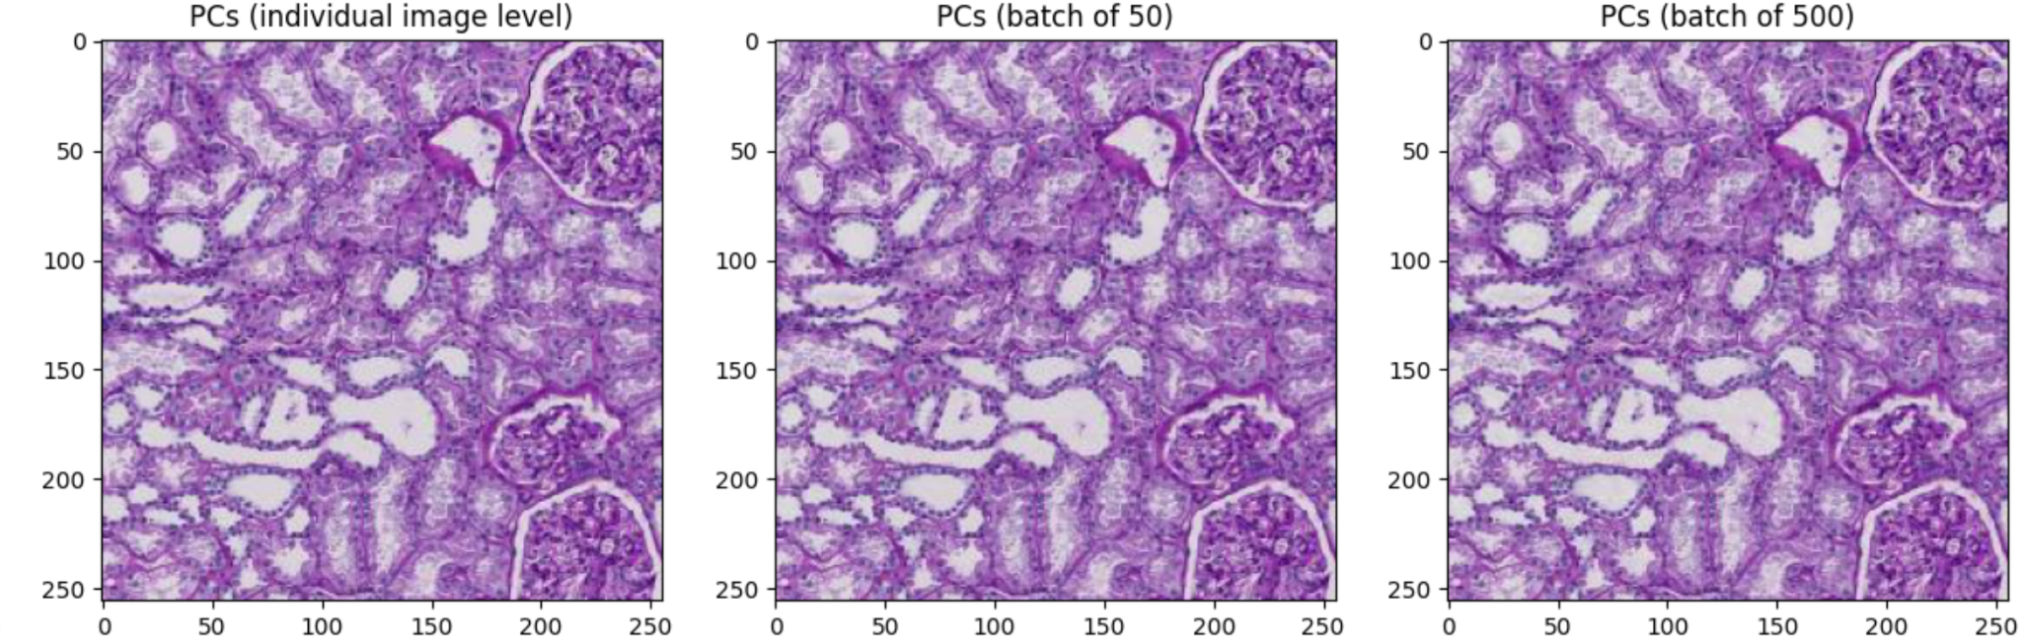
Results
PCs continued

Slide 10
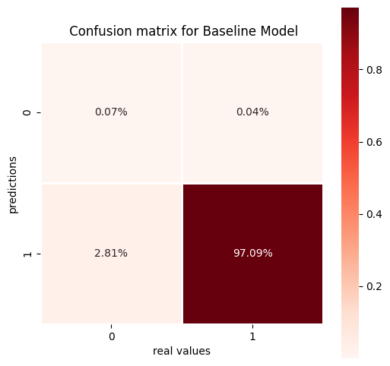



Evaluation
model | Precision | Recall | Dice loss | Val Dice coefficient | Pixel_wise test accuracy
Baseline model | 91.84% | 88.98% | 0.1318 | 0.8682 | 97.15%
model_individual | 91.42% | 86.78% | 0.1407 | 0.8593 | 97.12%
model_batch50 | 91.24% | 85.34% | 0.1754 | 0.8246 | 97.15%
model_batch500 | 89.54% | 78.54% | 0.2142 | 0.7858 | 97.16%
model | TP | FP | TN | FN
Baseline model | 74595 | 45840 | 109818627 | 3176074
model_individual | 44580 | 46955 | 109821270 | 3202331
model_batch50 | 66420 | 40826 | 109826506 | 3181384
model_batch500 | 137642 | 97239 | 109768819 | 3111436

Slide 11
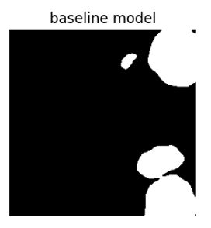
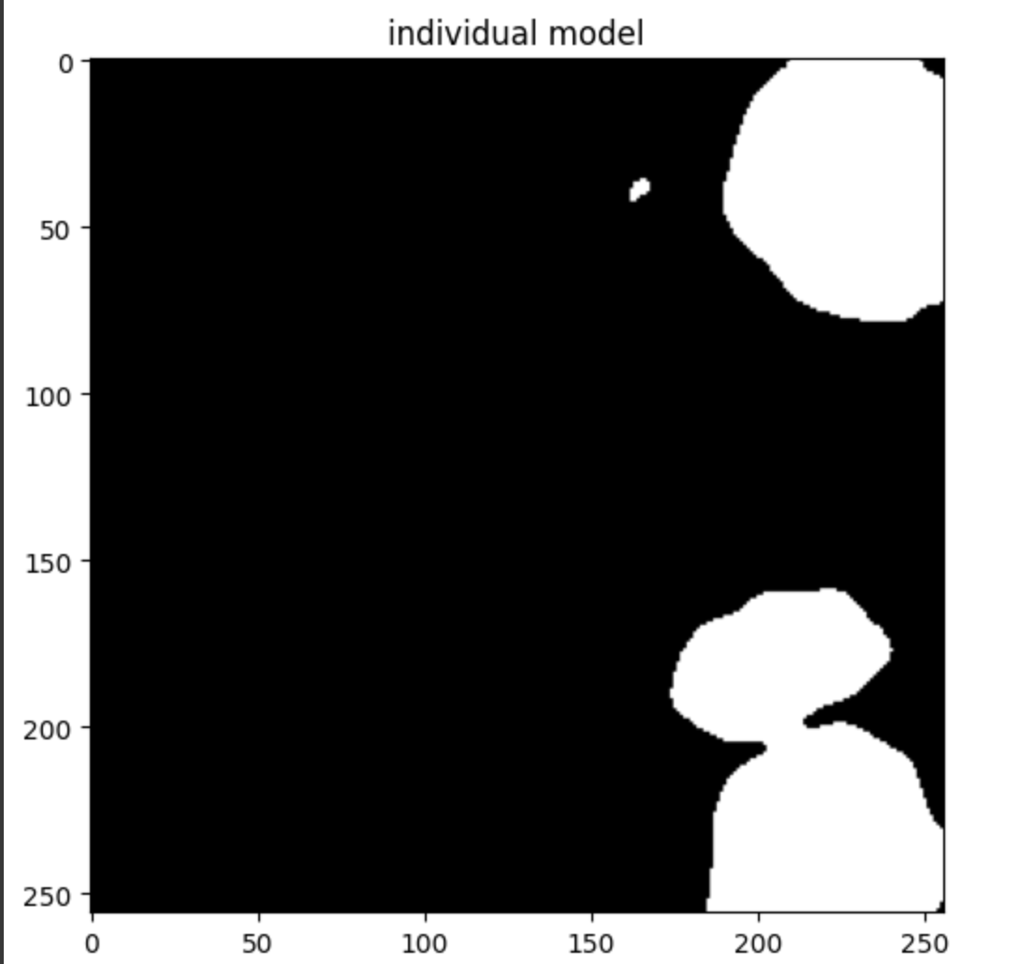
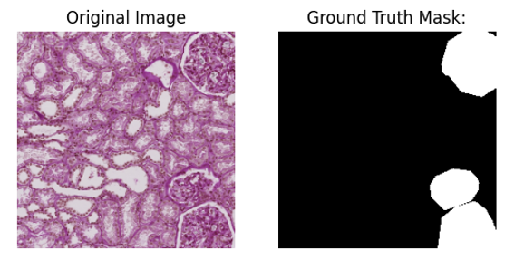
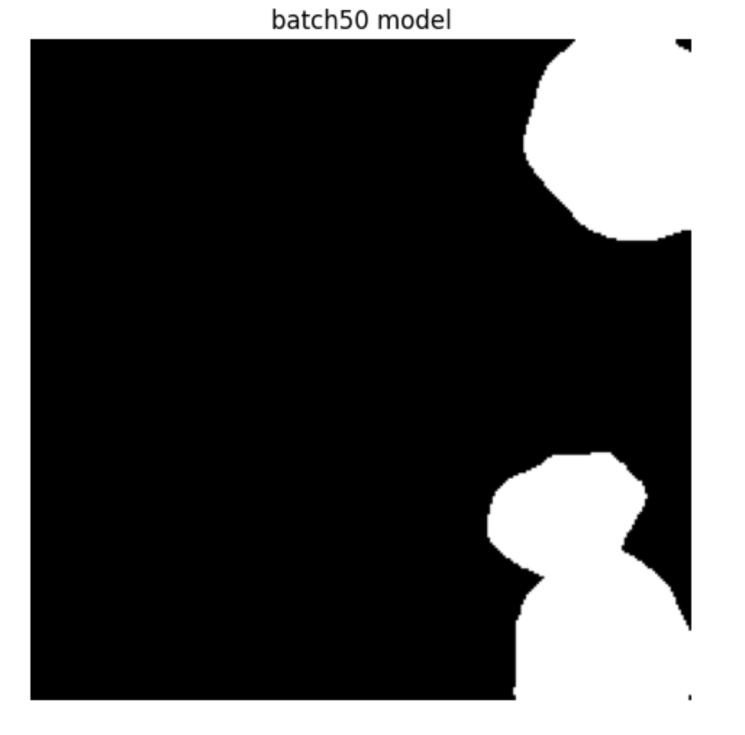

Prediction
Output
Trained baseline model
Corresponding reduced image tested with corresponding models
Output
Trained model_individual model
Input
Pre processing
Trained model batch50
Output
baseline image
Trained model batch500
Output

Slide 12
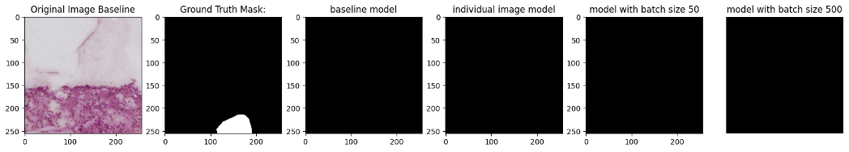
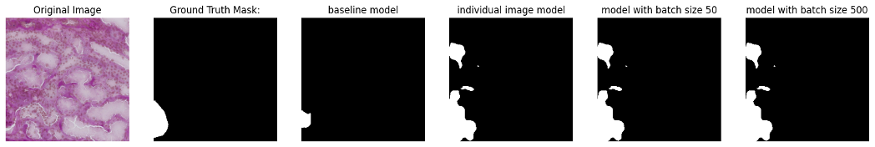
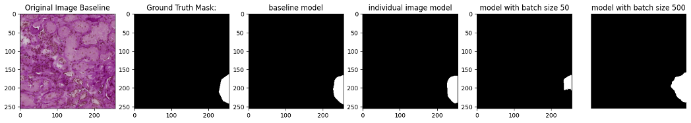
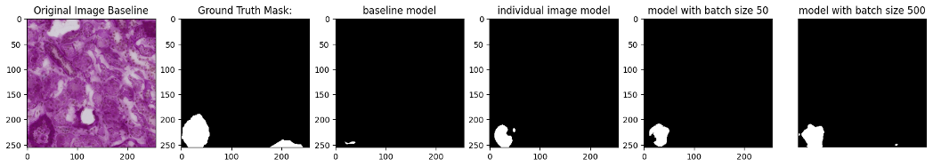
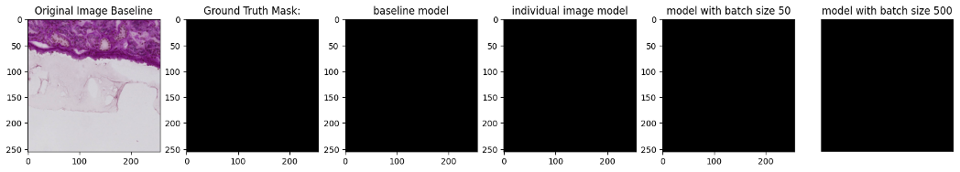

Slide 13
DEMO

Slide 14
CONCLUSION
This project aims to facilitate doctors and other medical professionals by saving their time by automatically segment the kidney in functional level
The Segmentation model captures glomeruli cell with precision of 91.84% and recall of 88.98% and dice coefficient of 0.8682.
Further improvement is required.
Further research can be carried out integrating weighted average of each model to give the final prediction.

Slide 15
QUESTIONS?
Is there any probability of data leakage ?
As far as I know, there is no leaking in case of model training. But in case of plotting model prediction, there might be a case of data leakage.
What technologies will we be using to implement this as a real world system?
Web framework: Create user interface for the system
Database Management System: To store data generated by this system
Containerization Tools: To deploy this system in a scalable and portable way, there will be need of containerization tools such as Docker or Kubernetes
What enhancements can we do to this?
Implement preprocessing effect for balancing the loss due to edge effect
Augment the image to be predicted, do prediction and deaugment the predictions and give weighted average of the predictions as the final prediction (Tigoudern & Alami Merrouni, 2021).
How are we going to predict on PCs implemented dataset, what are you going to do with batches?
This is why prediction on non-reduced image was carried out. Highly dependent on use case scenario.

Slide 16
References
HuBMAP - Hacking the Kidney | Kaggle. (n.d.). https://www.kaggle.com/c/hubmap-kidney-segmentation
HuBMAP 256x256. (2021, March 10). Kaggle. https://www.kaggle.com/datasets/iafoss/hubmap-256x256
Tigoudern, A., & Alami Merrouni, A. (2021). HubMap-Hacking the Kidney. Ecole Nationale des Sciences Appliquées de berrechid.

Slide 17
THANK YOU

